Slide 1
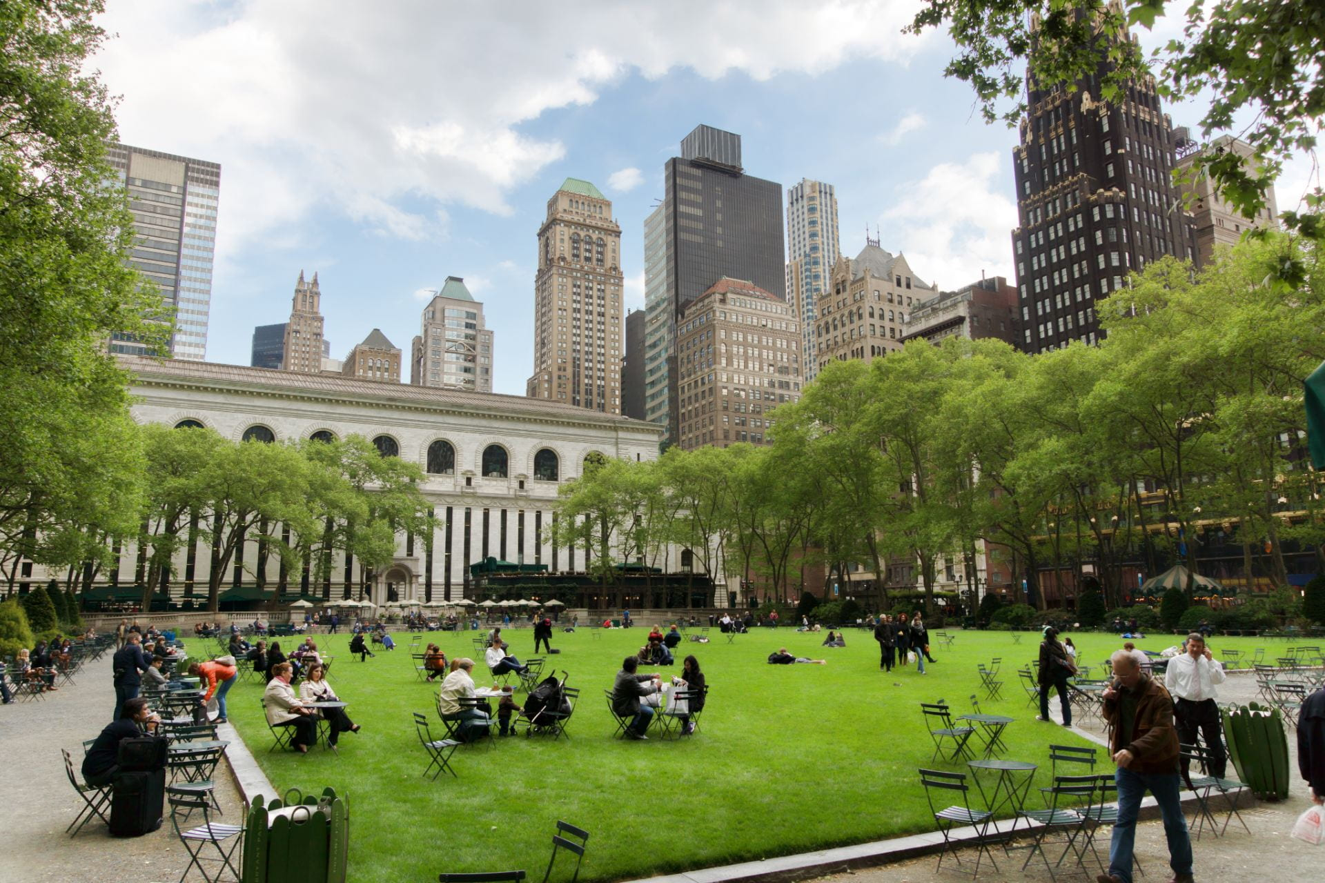
Conservation in the 21st Century
Dr Olivia Norfolk
Olivia.Norfolk@aru.ac.uk

Slide 2
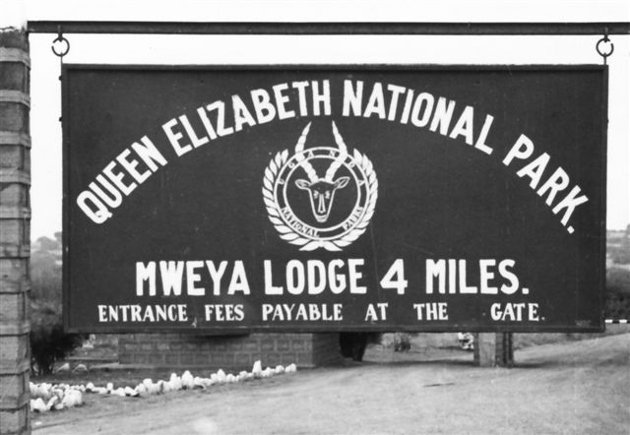
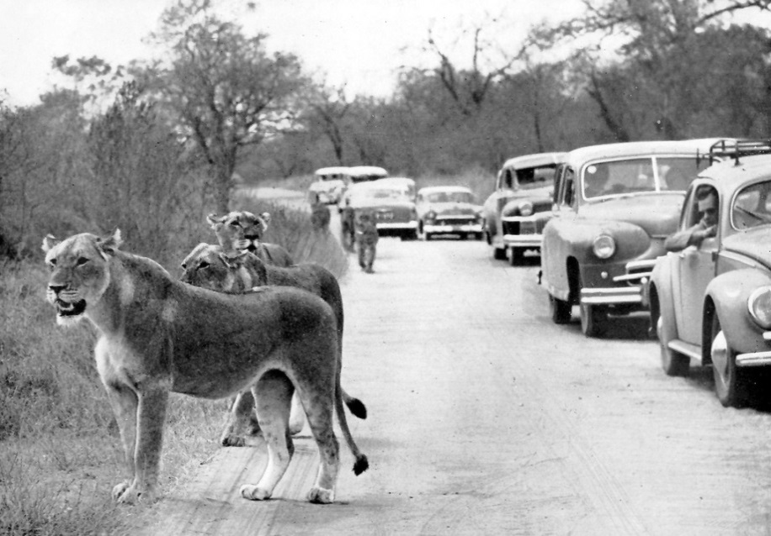
A brief history of conservation in the 19^{th-}20th Centuries
TRADITIONAL CONSERVATION - Protecting wilderness habitats and endangered species
National Parks established in the USA in 1870s.
UK followed by creating National Parks across the “Empire” – first in the New World (1880-90s- Canada, Australia, New Zealand) and later across Africa (1925-50s- D.R. Congo, S. Africa, Kenya, Tanzania, Uganda).
Strong ties to colonialism.
Local people excluded from parks.

Slide 3

A brief history of conservation…
It was not until the late 20th Century that local people and their livelihoods were formally considered in conservation efforts.
Original IUCN definition of National Park (1969)
ecosystems are not materially altered by human exploitation and occupation
competent authority has taken steps to eliminate exploitation or occupancy

Slide 4
A brief history of conservation…
Current IUCN definition of National Park (2018)
1. To manage visit use for inspirational, educational and cultural purposes at a level that will not cause degradation.
2. To take into account the needs of indigenous people, including subsistence resource use (in so far as these will not adversely affect the primary management objective).
3. To contribute to local economies through tourism.

Slide 5
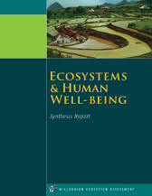
Policy shifts within the 21st Century
2005 The Millenium Ecosystem Assessment.
2011 UK National Ecosystem Assessment.
Reviewed provisioning, regulating, cultural and supporting services.
Shift from species to systems-based thinking.
Pivotal for driving movement towards quantifying the ecosystem service benefits that society gains from biodiversity.

Slide 6

2011 Aichi Biodiversity Targets (Convention on Biological Diversity, CBD)
All bar one UN member state Pledged to develop National Strategies to address the following Goals by 2020-
Strategic Goal A: Address the underlying causes of biodiversity loss by mainstreaming biodiversity across government and society
Strategic Goal B: Reduce the direct pressures on biodiversity and promote sustainable use
Strategic Goal C: To improve the status of biodiversity by safeguarding ecosystems, species and genetic diversity
Strategic Goal D: Enhance the benefits to all from biodiversity and ecosystem services
Strategic Goal E: Enhance implementation through participatory planning, knowledge management and capacity building

Slide 7
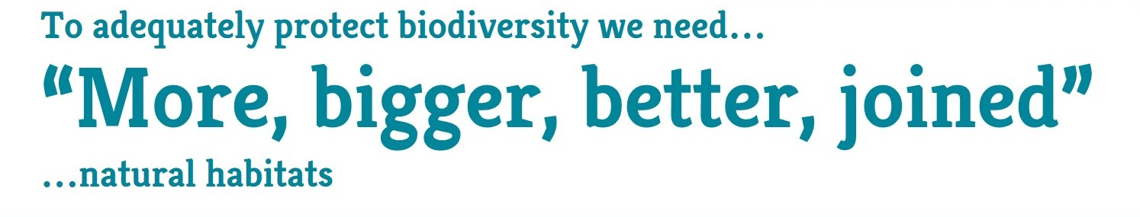
2010 Lawton Report, Making Space for Nature
Advisory committee asked how to maintain biodiversity in face of climate change.
Endorsed an approach based upon ecological networks and restoring landscape connectivity.

Slide 8
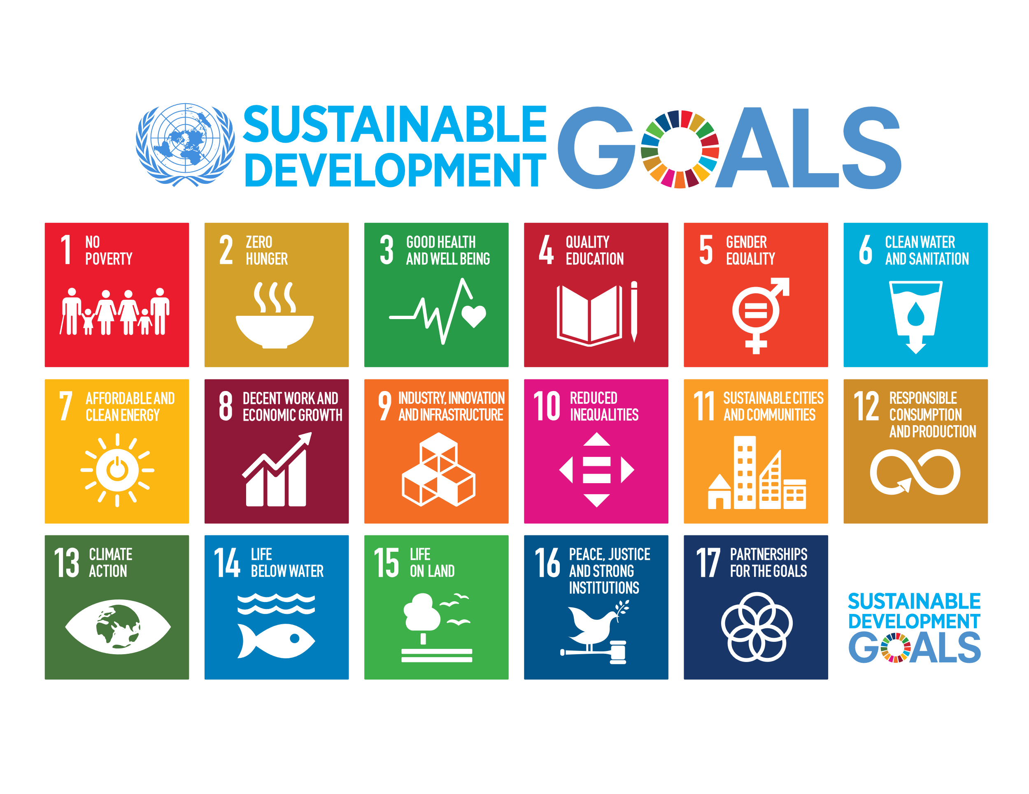
2015 Sustainable Development Goals (SDGs)
All member states of the United Nations pledge to achieve 17 SDGs by 2030.
Key goals are to end poverty, protect the planet and ensure that all people enjoy peace and prosperity.
An even greater acknowledgement of the connections between people and nature.

Slide 9

2020 New CBD Biodiversity Strategy to be decided following talks in Kunming, China, this October.
May 2019 A major report by the Intergovernmental Science-Policy Platform on Biodiversity and Ecosystem Services (Ipbes) warned species extinction was accelerating with ecosystems deteriorating at rates unprecedented in human history.
Targets had not been met!
Released draft indicates - by 2030 At least 30% of the world’s land and seas should be protected to prevent destruction of the earths biodiversity.

Slide 10
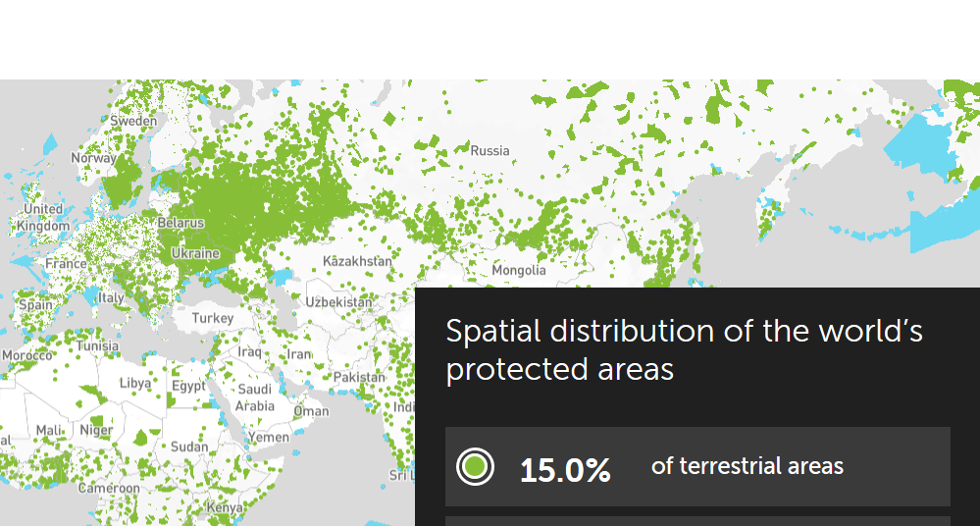
Are we on track?
Between 2016 and 2020- the global coverage of protected areas rose from:
14.7% in 2016 to 15.0% in terrestrial systems.
And from 10.2% to 17.3% in marine systems (National Waters only).
Protected Planet Report 2020 (UNEP-WCMC, IUCN and NGS (2020)
Check-out their interactive maps of our planets protected areas-
https://livereport.protectedplanet.net/chapter-2

Slide 11
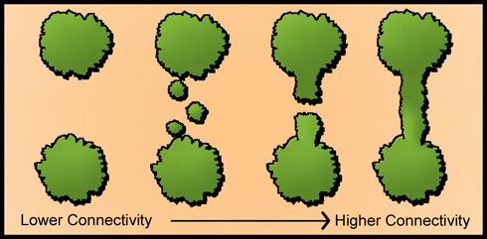
Bigger is better, but are they joined?
The Lawton Report called for BIGGER, BETTER, MORE, JOINED.
But Just 10% of the global terrestrial protected area network is structurally connected via intact land.
Not sufficient to allow the population shifts required in response to climate change.
Is not adequate for allowing population shifts which is particularly valuable given climate change.
Ward et al. (2020) Nature https://www.nature.com/articles/s41467-020-18457-x

Slide 12
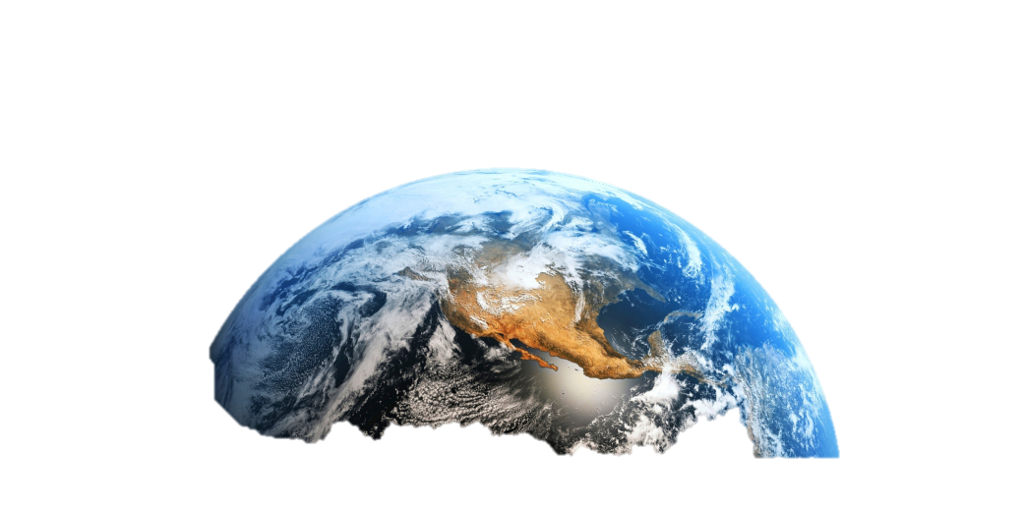
Is 30% ambitious enough?
Half-Earth: Our Planet's Fight for Life – published by renowned ecologist E. O. Wilson in 2016
Suggests that 50% of the land and sea must be protected in order to reverse the species extinction crisis and ensure the long-term health of our planet
https://www.youtube.com/watch?v=lmoD-pNANWo

Slide 13
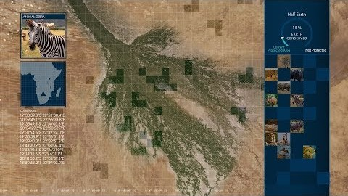
The Half-Earth Project Half-Earth is a call to protect half the land and sea in order to manage sufficient habitat to reverse the species extinction crisis and ensure the long-term health of our planet. The Half-Earth Project is bringing this goal to life.
The Half-Earth Project Half-Earth is a call to protect half the land and sea in order to manage sufficient habitat to reverse the species extinction crisis and ensure the long-term health of our planet. The Half-Earth Project is bringing this goal to life.
Notes:
https://www.youtube.com/Link - watch? https://www.youtube.com/watch?v=6fGJafDDCksv=6fGJafDDCks

Slide 14

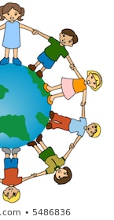
Half-Earth or Whole Earth?
The Half-Earth Project Half-Earth is a call to protect half the land and sea in order to manage sufficient habitat to reverse the species extinction crisis and ensure the long-term health of our planet. The Half-Earth Project is bringing this goal to life.
The Half-Earth Project Half-Earth is a call to protect half the land and sea in order to manage sufficient habitat to reverse the species extinction crisis and ensure the long-term health of our planet. The Half-Earth Project is bringing this goal to life.
Caused controversy – enormous social challenges, compromising rights and livelihoods of vulnerable people.
Cristiana Paşca Palmer, the Executive Secretary of CBD coined a new concept in 2018:
HE + SHE = WE
Half-Earth + Shared Half Earth = Whole Earth

Slide 15
Half Earth or Whole Earth?
Now you decide..
After this session read and reflect upon-
“Half-Earth or Whole Earth? Radical ideas for conservation, and their implications. (Buscher et al. 2017)
Followed by Dr Chris Sandbrooks blog article on the topic – “A tale of he, she, we and me”.
Notes:
1. https://www.researchgate.net/publication/311443564_Half-Earth_or_Whole_Earth_Radical_ideas_for_conservation_and_their_implications
2 https://thinkinglikeahuman.com/2018/08/09/a-tale-of-he-she-we-and-me/
.

